Slide 1
Features of java

Slide 2
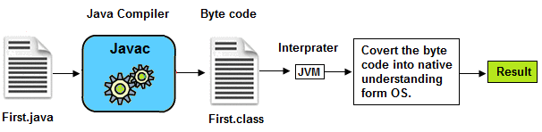
1. Easy to develop applications
As compare to C and C++ , no pointer concept
Atomatic memory allocation and deallocation
Which makes easy to develop applications.

Slide 3
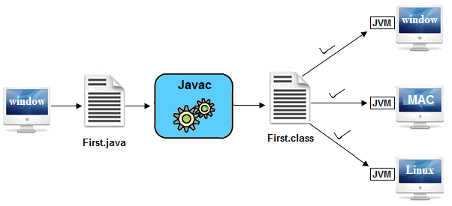
2. Platform Independent

Slide 4
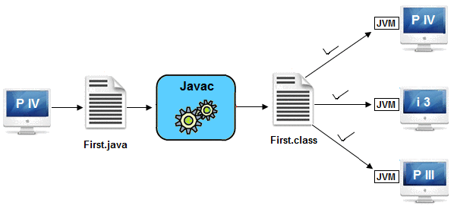
3. Architectural Neutral
Architecture represents processor.
It can run on any processor

Slide 5

4. Portable
Platform independent and architectural neutral features makes its portable.

Slide 6
5. Multithreaded
you can perform multiple operations at the same time.
Threads are independent, so it doesn't affect other threads.

Slide 7


Multithreading Example

Slide 8
Examples:
Typing MS Word document while listening to music.
You can use multiple objects in games like cars, motor bikes, animals, people etc.
Railway ticket reservation system where multiple customers accessing the server.
Multiple account holders accessing their accounts simultaneously on the server. When you insert a ATM card, it starts a thread for perform your operations.

Slide 9
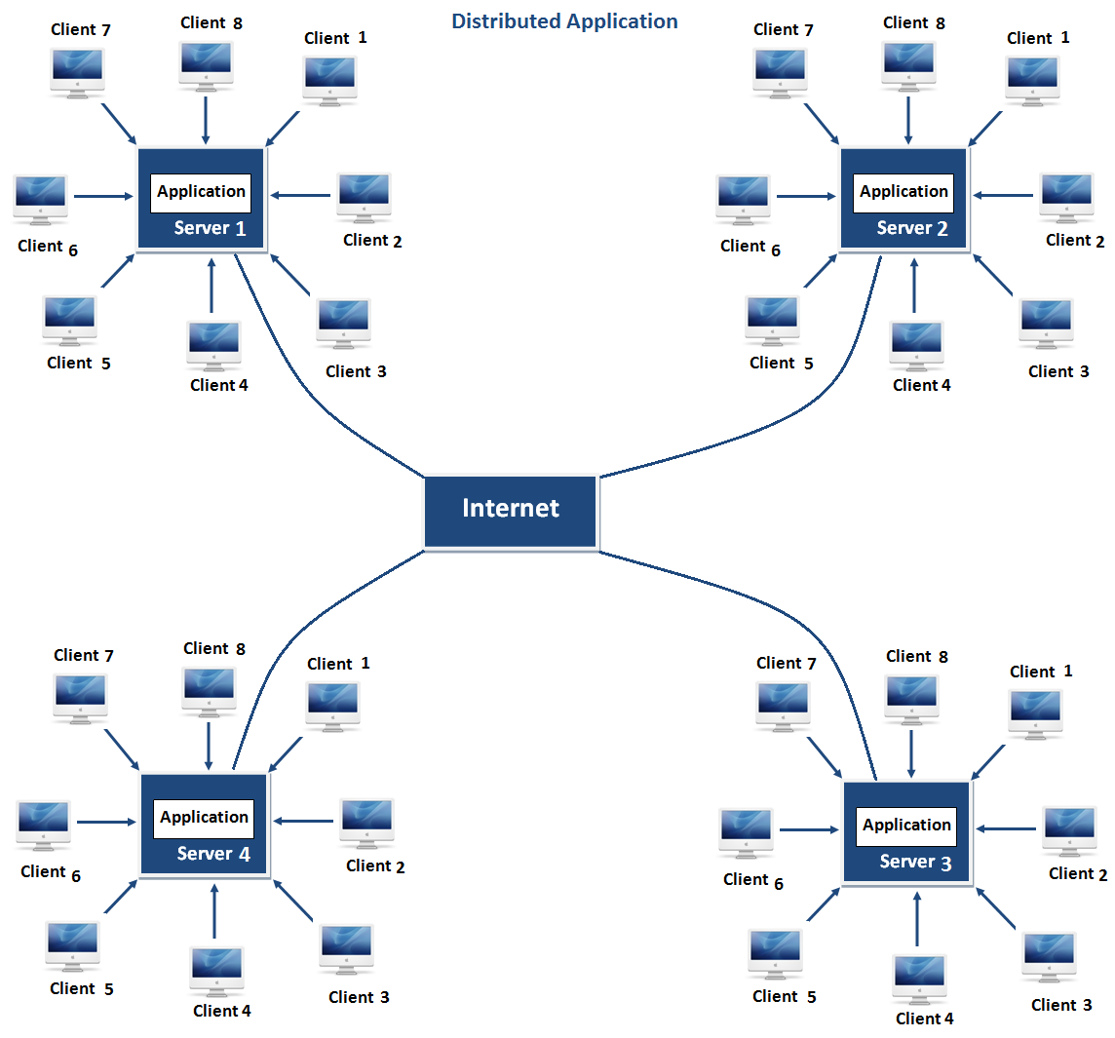
6. Distributed
Same application can run in different different server.
Advantage:problem occurred in one server will never be reflected on any client system.

Slide 10
7. Robust
It is robust or strong Programming Language because of its capability to handle Run-time Error, automatic garbage collection, the lack of pointer concept, Exception Handling. All these points make It robust Language.

Slide 11
8. Object Oriented
Java is OOPs based
Data Encapsulation
Data Abstraction
Polymorphism
Inheritance

Slide 12
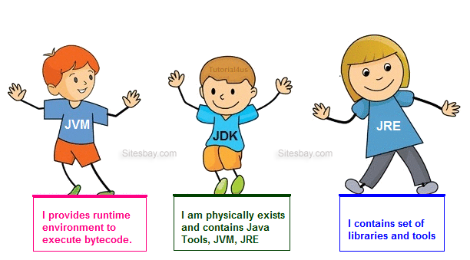
Working of JVM, JDK and JRE

